Slide 1
I-O Redirection
Tanjin Sharma , MS Data Science , University of San Francisco
Srividya Krithivasan, MS Data Science, University of San Francisco

Slide 2


Slide 3
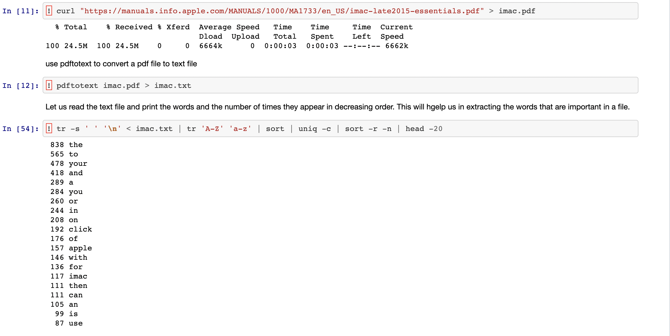

Slide 4
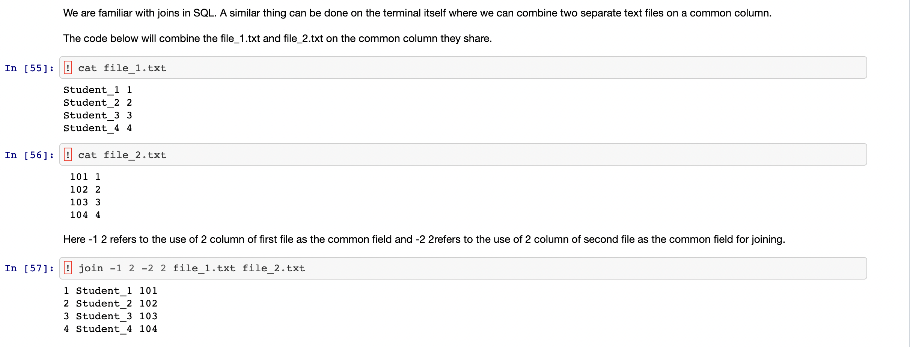

Slide 5
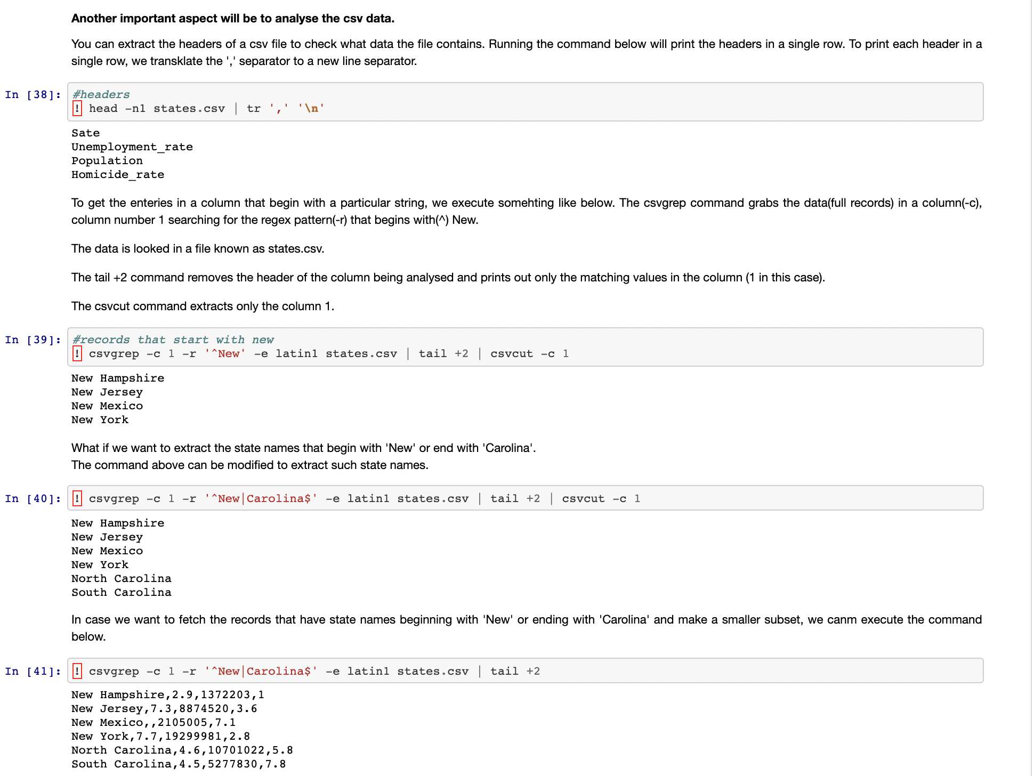

Slide 6
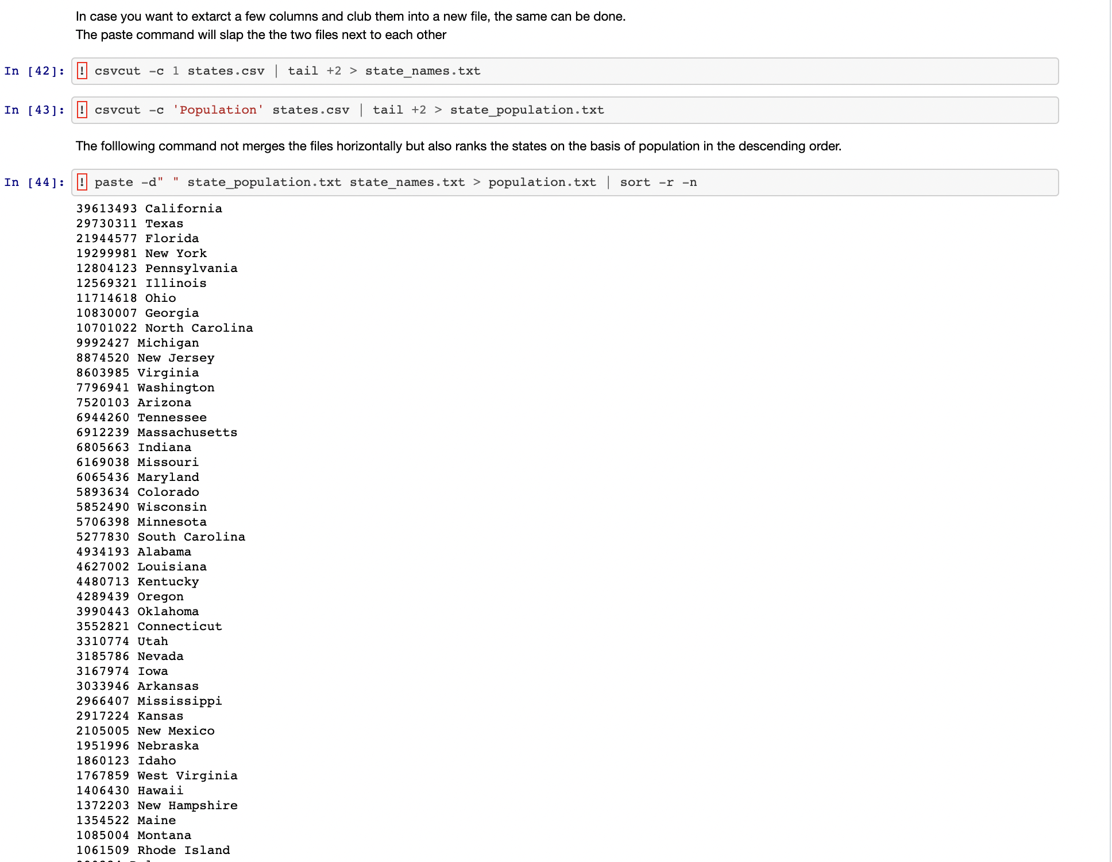

Slide 7
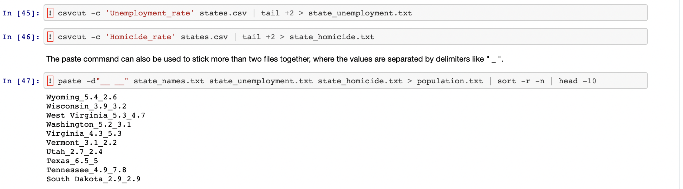

Slide 8
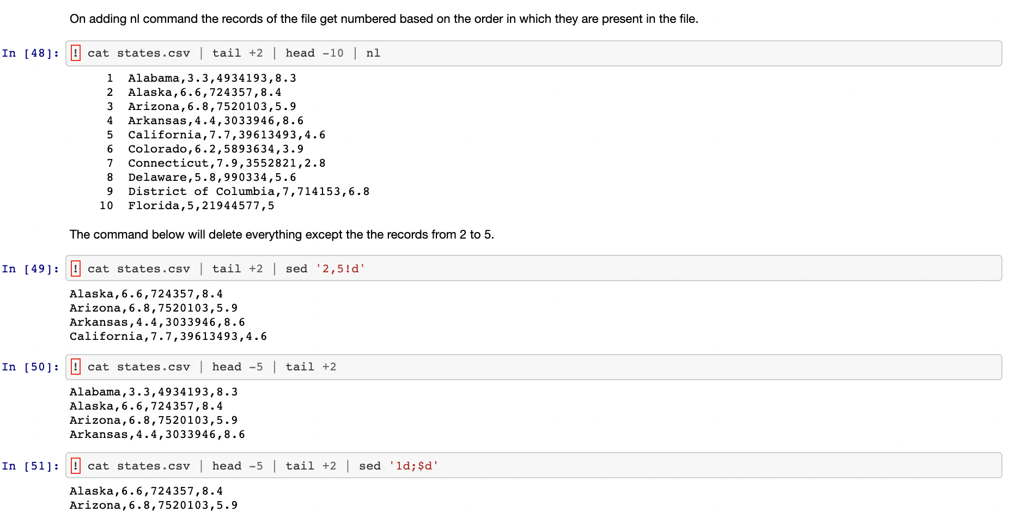

Slide 9
Thank You

Slide 10
Questions

